Slide 1
POLYGONS

Slide 2
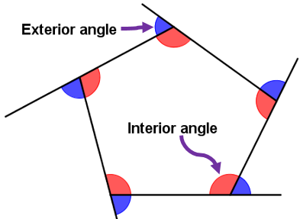
180° - exterior angle
180- 72= 108°

Slide 3
HOW TO CALCULATE THE INTERIOR AND EXTERIOR ANGLES OF
REGULAR POLYGONS
In regular polygons all interior angles measure the same, all exterior angles measure the same and all sides measure the same.
Formula to calculate the interior angles of a polygon, where n is the number of sides
Int. angle = (n-2) * 180
n
As you can see in the figure, the interior and exterior angles are SUPPLEMENTARY…SO …
Ext. angle = 180°- Int. angle

Slide 4
EXAMPLES
Int. angle = (3-2) * 180
3
Int. angle = (1) * 180 = 180 = 60°
3 3
HELP?
Int. angle = 60°
https://www.youtube.com/watch?v=8se3NJ2bfSg
Ext. angle = 180° - 60° = 120°
Int. angle = (5-2) * 180
5
Int. angle = (3) * 180 = = 540° = 108°
5 5
Int. angle = 108°
Ext. angle = 180° - 108° = 72°

Slide 5
Complete the HIGHLIGHTED columns. Use the formula to calculate the interior and exterior angles of each REGULAR shape. Write the operations in the folder so I can see them.
NUMBER OF SIDES | NAME | CENTRAL ANGLE | INTERIOR ANGLES | SUM OF INTERIOR ANGLES | EXTERIOR ANGLES
3 | Equilateral triangle | 120° | 60° | 180° | 120°
4 | Square | 90° |  | 360°
5 | Pentagon |  | 108° | 540°
6
7
8
9
10
11
12

Slide 6
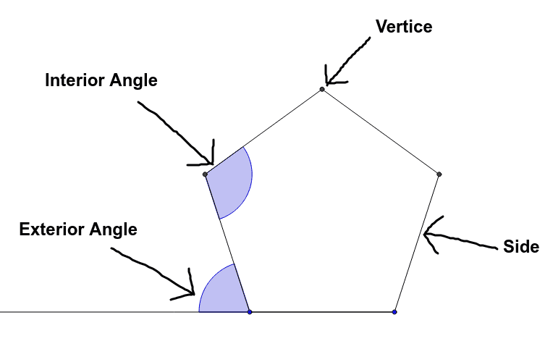
FINAL WORK
DRAW A POLYGON (except a pentagon) USING A PAIR OF COMPASSES AND A PROTRACTOR
NAME THE PARTS AND CALCULATE THE CENTRAL, INTERIOR AND EXTERIOR ANGLES
EXAMPLE
Interior angle: 108°
Central Angle
Central angle: 72°
Exterior angle: 72°

Slide 7
If you want to learn more and have more practice, you can visit these sites.
https://www.mathsisfun.com/geometry/polygons.html
https://www.khanacademy.org/math/basic-geo/basic-geometry-shapes/basic-geo-properties-shapes/a/polygons-review
Questions? You don´t understand? Contact me at ltovar@spatricio.com.ar
Once your work is ready, send it ltovar@spatricio.com.ar

